Slide 1
Methods
QuyenNV

Slide 2
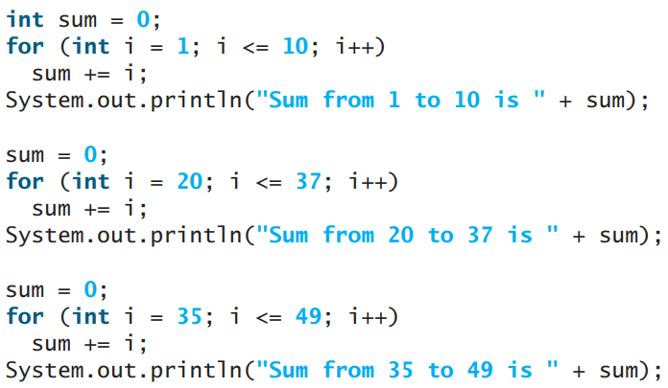
WHY METHODS?
Methods is a collection of statements grouped together to perform an operation which can be used to define reusable code and organize and simplify coding.
Suppose that you need to find the sum of integers from 1 to 10, from 20 to 37, and from 35 to 49, respectively. You may write the code as follows:

Slide 3
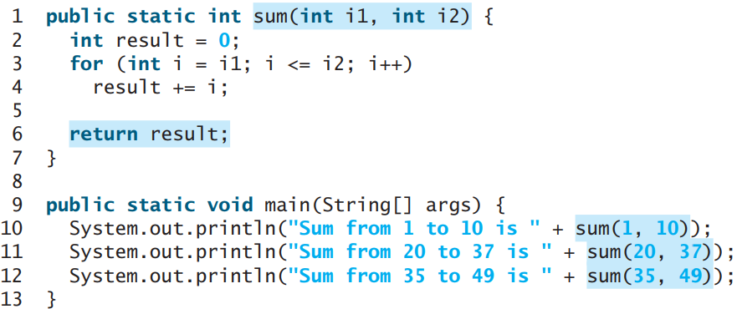
WHY METHODS?
You may have observed that computing these sums from 1 to 10, from 20 to 37, and from 35 to 49 are very similar except that the starting and ending integers are different. Wouldn’t it be nice if we could write the common code once and reuse it? We can do so by defining a method and invoking it. The preceding code can be simplified as follows:

Slide 4
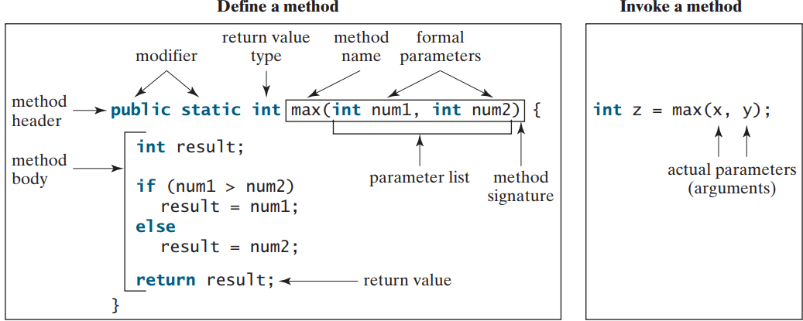
HOW TO DEFINE A METHODS?
The syntax for defining a method is as follows:
modifier returnValueType methodName(list of parameters) { // Method body; }

Slide 5
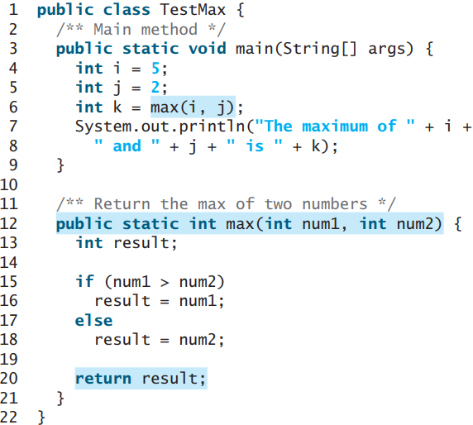
HOW TO CALL A METHODS?

Slide 6
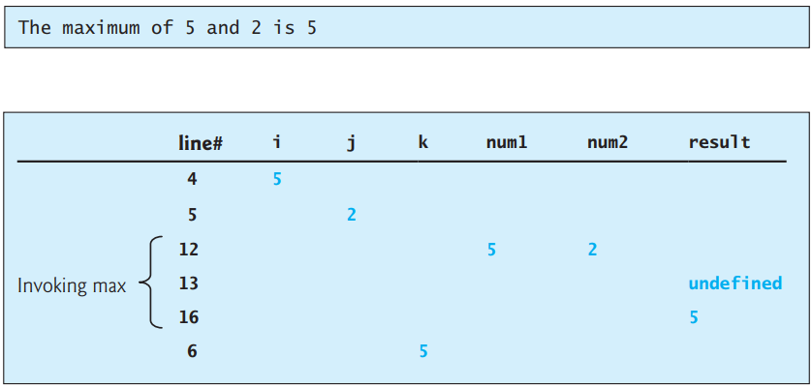
HOW TO CALL A METHODS?

Slide 7
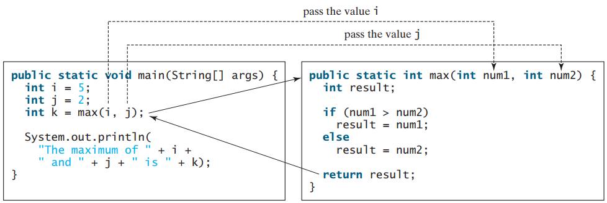
HOW TO CALL A METHODS?

Slide 8
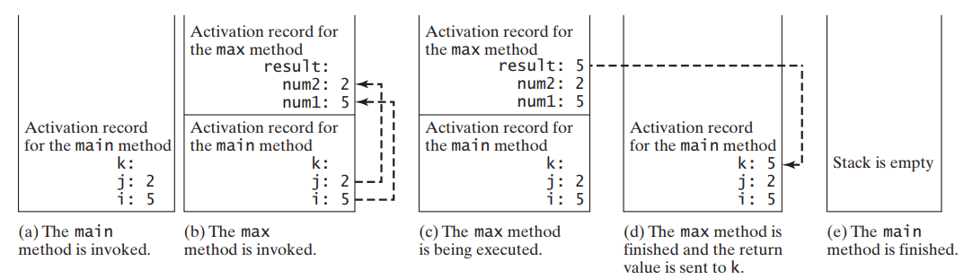
HOW TO CALL A METHODS?

Slide 9
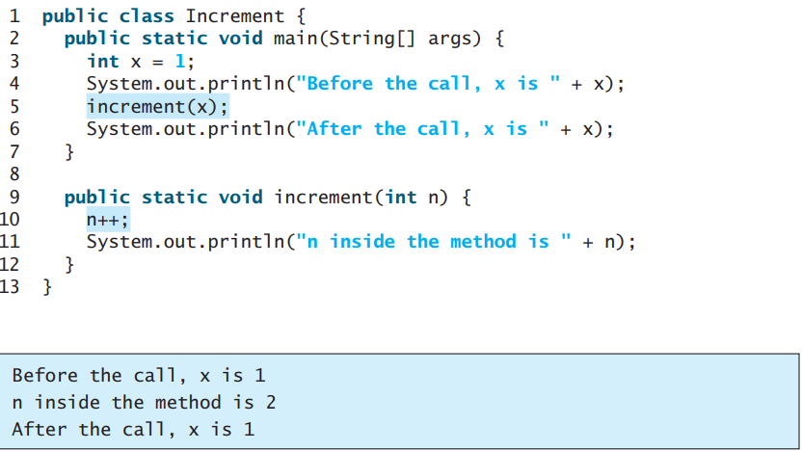
PASS ARGS BY VALUES
Notes:
When you invoke a method with an argument, the value of the argument is passed to the parameter. This is referred to as pass-by-value

Slide 10
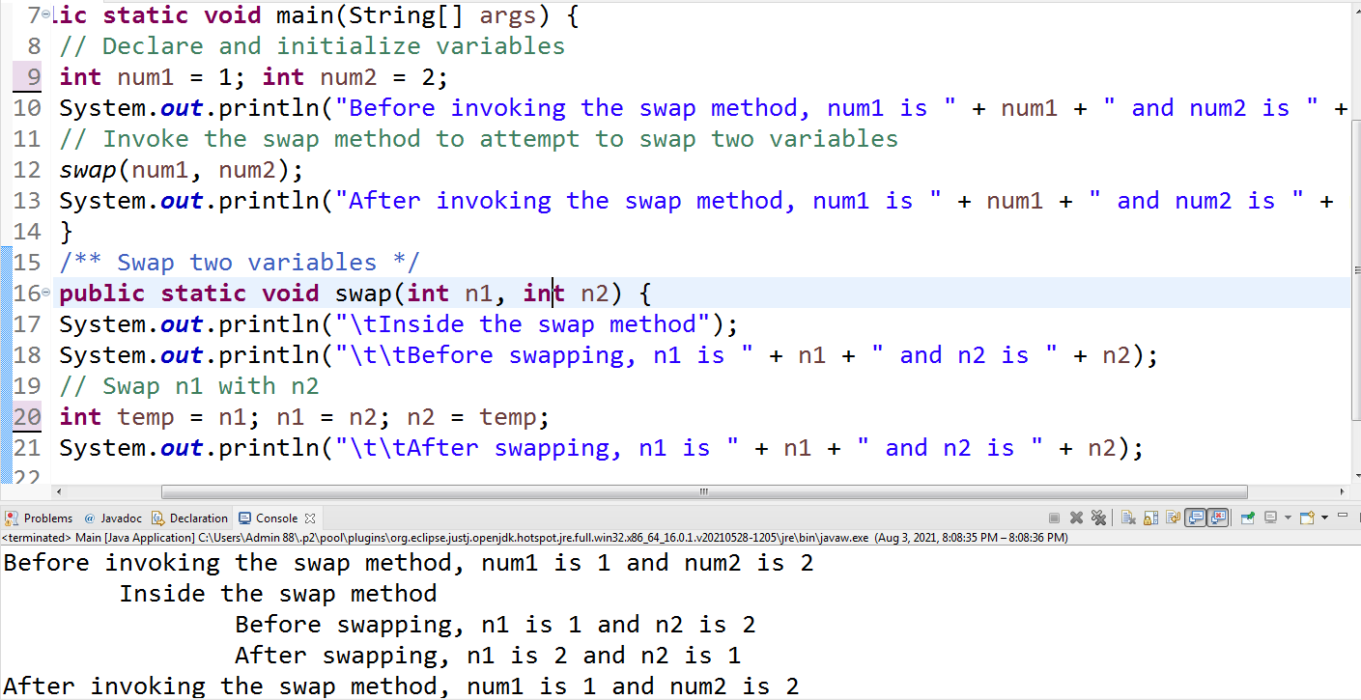
PASS ARGS BY VALUES
Notes:
package firstdemo;import java.util.Date;import java.util.Scanner;public class Main { public static void main(String[] args) { // Declare and initialize variables int num1 = 1; int num2 = 2; System.out.println("Before invoking the swap method, num1 is " + num1 + " and num2 is " + num2); // Invoke the swap method to attempt to swap two variables swap(num1, num2); System.out.println("After invoking the swap method, num1 is " + num1 + " and num2 is " + num2); } /** Swap two variables */ public static void swap(int n1, int n2) { System.out.println("\tInside the swap method"); System.out.println("\t\tBefore swapping, n1 is " + n1 + " and n2 is " + n2); // Swap n1 with n2 int temp = n1; n1 = n2; n2 = temp; System.out.println("\t\tAfter swapping, n1 is " + n1 + " and n2 is " + n2); }}

Slide 11
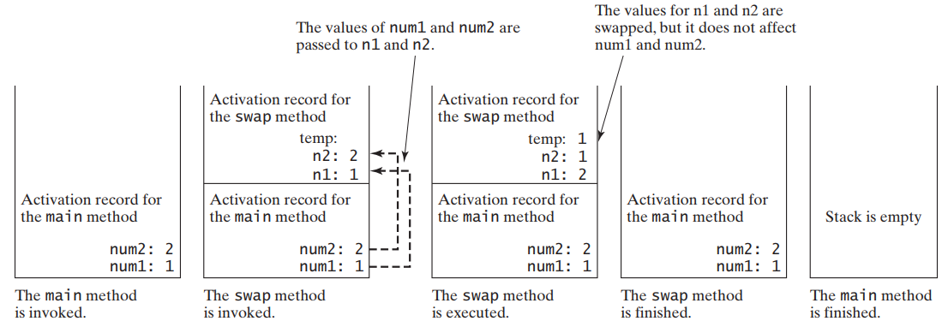
PASS ARGS BY VALUES

Slide 12
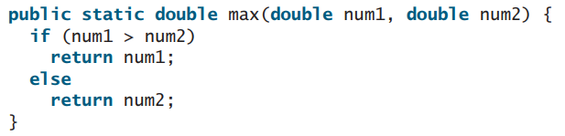
OVERLOADING METHOD
Overloading methods enables you to define the methods with the same name as long as their signatures are different
The max method that was used earlier works only with the int data type. But what if you need to determine which of two floating-point numbers has the maximum value? The solution is to create another method with the same name but different parameters, as shown in the following code:
Notes:
package firstdemo;import java.util.Date;import java.util.Scanner;public class Main { public static void main(String[] args) { { return max(max(num1, num2), num3); }} // Invoke the max method with int parameters System.out.println("The maximum of 3 and 4 is " + max(3, 4)); // Invoke the max method with the double parameters System.out.println("The maximum of 3.0 and 5.4 is " + max(3.0, 5.4)); // Invoke the max method with three double parameters System.out.println("The maximum of 3.0, 5.4, and 10.14 is " + max(3.0, 5.4, 10.14)); } /** Return the max of two int values */ public static int max(int num1, int num2) { if (num1 > num2) return num1; else return num2; } /** Find the max of two double values */ public static double max(double num1, double num2) { if (num1 > num2) return num1; else return num2; } /** Return the max of three double values */ public static double max(double num1, double num2, double num3)

Slide 13
VARIABLES SCOPE
The scope of a variable is the part of the program where the variable can be referenced.
A variable defined inside a method is referred to as a local variable. The scope of a local variable starts from its declaration and continues to the end of the block that contains the variable. A local variable must be declared and assigned a value before it can be used.
A parameter is actually a local variable. The scope of a method parameter covers the entire method. A variable declared in the initial-action part of a for-loop header has its scope in the entire loop. However, a variable declared inside a for-loop body has its scope limited in the loop body from its declaration to the end of the block that contains the variable.

Slide 14
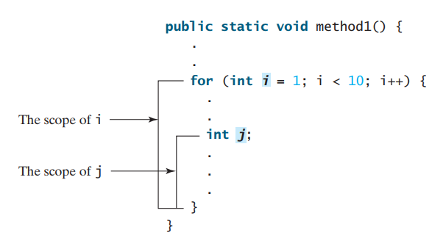
VARIABLES SCOPE

Slide 15
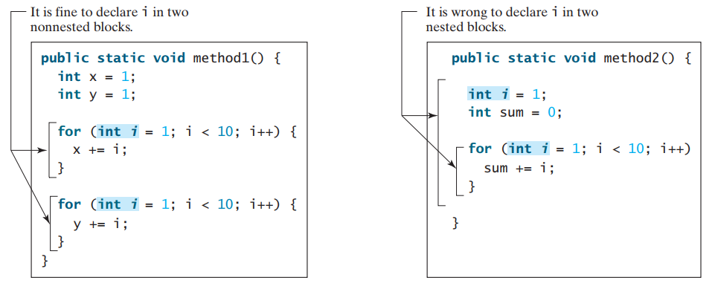
VARIABLES SCOPE

Slide 16
Case study: Generate random char
Computer programs process numerical data and characters. You have seen many examples that involve numerical data. It is also important to understand characters and how to process them. This section presents an example of generating random characters.
As introduced before, every character has a unique Unicode between 0 and FFFF in hexadecimal (65535 in decimal). To generate a random character is to generate a random integer between 0 and 65535 using the following expression (note that since 0 <= Math.random() < 1.0, you have to add 1 to 65535):
(int)(Math.random() * (65535 + 1))
Now let’s consider how to generate a random lowercase letter. The Unicodes for lowercase letters are consecutive integers starting from the Unicode for a, then that for b, c, . . . , and z
The Unicode for a is
(int)'a'
Notes:
package firstdemo;import java.util.Date;import java.util.Scanner;public class Main { /** Generate a random character between ch1 and ch2 */ public static char getRandomCharacter(char ch1, char ch2) { return (char) (ch1 + Math.random() * (ch2 - ch1 + 1)); } /** Generate a random lowercase letter */ public static char getRandomLowerCaseLetter() { return getRandomCharacter('a', 'z'); } /** Generate a random uppercase letter */ public static char getRandomUpperCaseLetter() { return getRandomCharacter('A', 'Z'); } /** Generate a random digit character */ public static char getRandomDigitCharacter() { return getRandomCharacter('0', '9'); } /** Generate a random character */ public static char getRandomCharacter() { return getRandomCharacter('\u0000', '\uFFFF'); } public static void main(String[] args) { final int NUMBER_OF_CHARS = 175; final int CHARS_PER_LINE = 25; // Print random characters between 'a' and 'z', 25 chars per line for (int i = 0; i < NUMBER_OF_CHARS; i++) { char ch = getRandomLowerCaseLetter(); if ((i + 1) % CHARS_PER_LINE == 0) System.out.println(ch); else System.out.print(ch); } }}

Slide 17
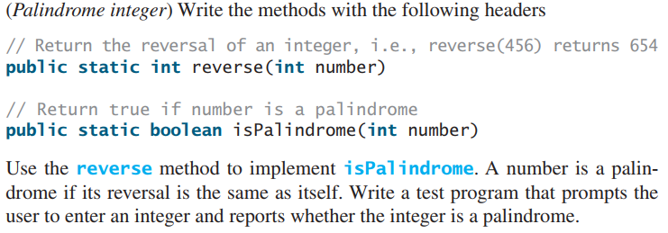
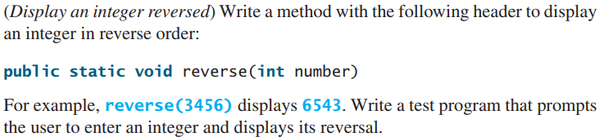
Exercise I + II

Slide 18
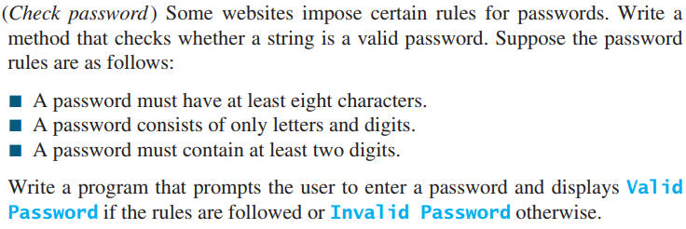
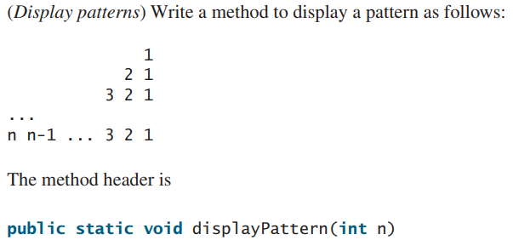
Exercise III + IV

Slide 19
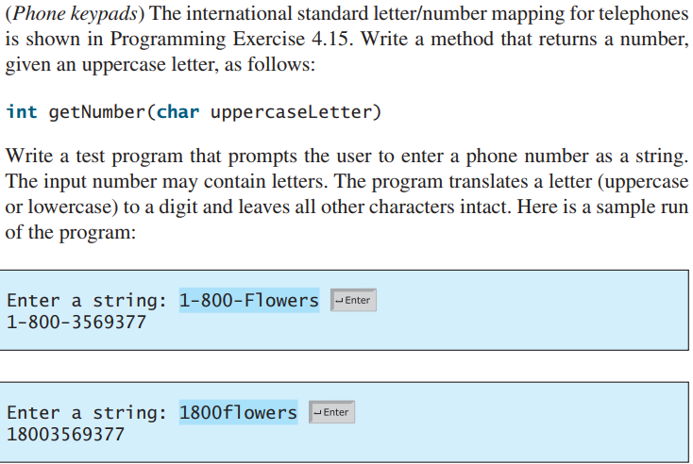
Exercise V

Slide 20
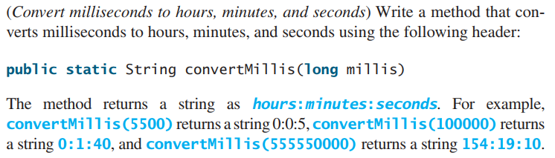
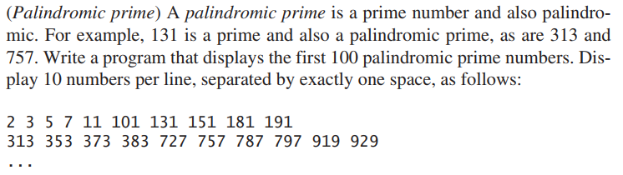
Exercise VI + VII

Slide 21
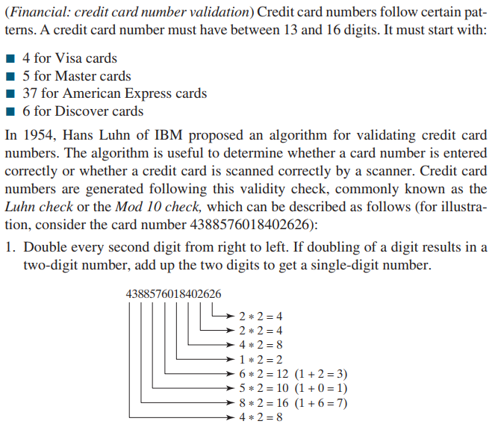
Exercise VIII

Slide 22
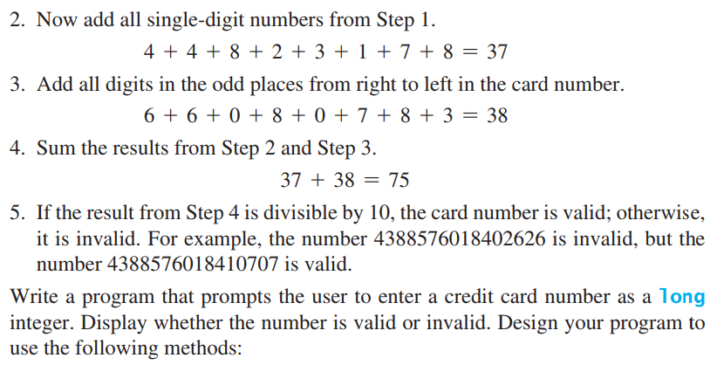
Exercise VIII

Slide 23
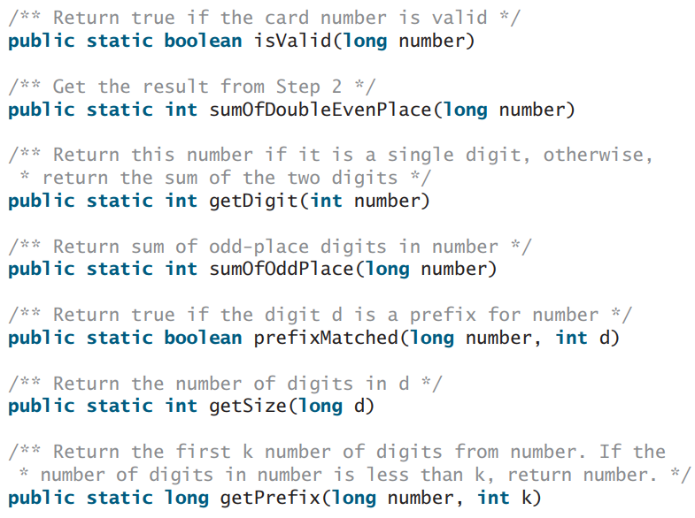
Exercise VIII

Slide 24
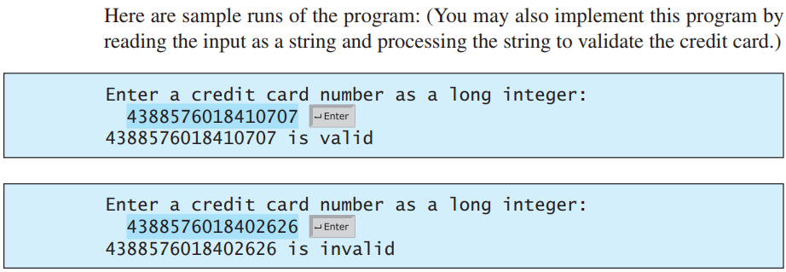
Exercise VIII

